Slide 1
Military Technical Academy
Principles of Programming Language
Data Types

Slide 2
Topics
Introduction
Primitive Data Types
Character String Types
User-Defined Ordinal Types
Array Types
Associative Arrays
Record Types
Union Types
Pointer and Reference Types

Slide 3
Introduction
A data type defines a collection of data objects and a set of predefined operations on those objects
A descriptor is the collection of the attributes of a variable
An object represents an instance of a user-defined (abstract data) type
One design issue for all data types: What operations are defined and how are they specified?

Slide 4
Primitive Data Types
Almost all programming languages provide a set of primitive data types
Primitive data types: Those not defined in terms of other data types
Some primitive data types are merely reflections of the hardware
Others require only a little non-hardware support for their implementation

Slide 5
Primitive Data Types: Integer
Almost always an exact reflection of the hardware so the mapping is trivial
There may be as many as eight different integer types in a language
Java’s signed integer sizes: byte, short, int, long

Slide 6
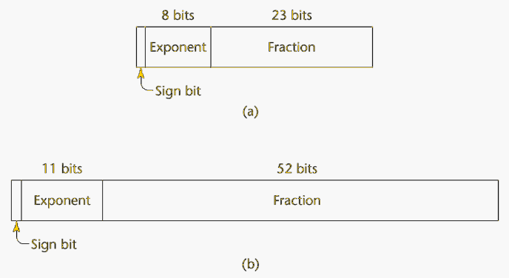
Primitive Data Types: Floating Point
Model real numbers, but only as approximations
Languages for scientific use support at least two floating-point types (e.g., float and double; sometimes more
Usually exactly like the hardware, but not always
IEEE Floating-Point Standard 754

Slide 7
Primitive Data Types: Complex
Some languages support a complex type, e.g., Fortran and Python
Each value consists of two floats, the real part and the imaginary part
Literal form (in Python):
  (7 + 3j), where 7 is the real part and 3 is the imaginary part

Slide 8
Primitive Data Types: Decimal
For business applications (money)
  Essential to COBOL
  C# offers a decimal data type
Store a fixed number of decimal digits, in coded form (BCD)
Advantage: accuracy
Disadvantages: limited range, wastes memory

Slide 9
Primitive Data Types: Boolean
Simplest of all
Range of values: two elements, one for “true” and one for “false”
Could be implemented as bits, but often as bytes
  Advantage: readability

Slide 10
Primitive Data Types: Character
Stored as numeric codings
Most commonly used coding: ASCII
An alternative, 16-bit coding: Unicode
  Includes characters from most natural languages
  Originally used in Java
  C# and JavaScript also support Unicode

Slide 11
Character String Types
Values are sequences of characters
Design issues:
  Is it a primitive type or just a special kind of array?
  Should the length of strings be static or dynamic?

Slide 12
Character String Types Operations
Typical operations:
  Assignment and copying
  Comparison (=, >, etc.)
  Catenation
  Substring reference
  Pattern matching

Slide 13
Character String Type in Certain Languages
C and C++
  Not primitive
  Use char arrays and a library of functions that provide operations
SNOBOL4 (a string manipulation language)
  Primitive
  Many operations, including elaborate pattern matching
Fortran and Python
  Primitive type with assignment and several operations
Java
  Primitive via the String class
Perl, JavaScript, Ruby, and PHP
- Provide built-in pattern matching, using regular expressions

Slide 14
Character String Length Options
Static: COBOL, Java’s String class
Limited Dynamic Length: C and C++
  In these languages, a special character is used to indicate the end of a string’s characters, rather than maintaining the length
Dynamic (no maximum): SNOBOL4, Perl, JavaScript
Ada supports all three string length options

Slide 15
Character String Type Evaluation
Aid to writability
As a primitive type with static length, they are inexpensive to provide--why not have them?
Dynamic length is nice, but is it worth the expense?

Slide 16
Character String Implementation
Static length: compile-time descriptor
Limited dynamic length: may need a run-time descriptor for length (but not in C and C++)
Dynamic length: need run-time descriptor; allocation/de-allocation is the biggest implementation problem

Slide 17
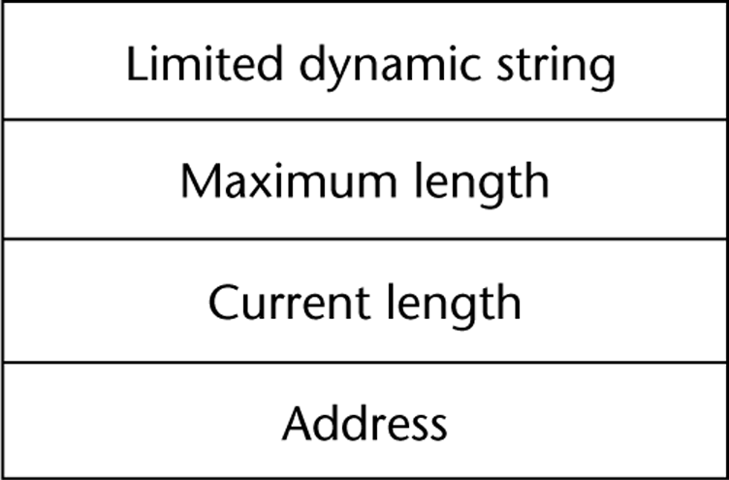
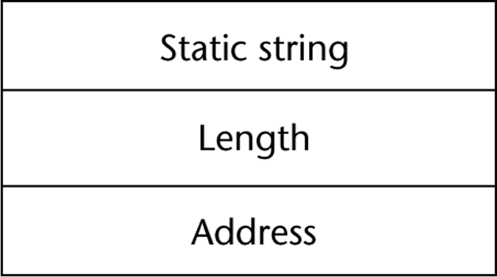
Compile- and Run-Time Descriptors
Compile-time descriptor for static strings
Run-time descriptor for limited dynamic strings

Slide 18
User-Defined Ordinal Types
An ordinal type is one in which the range of possible values can be easily associated with the set of positive integers
Examples of primitive ordinal types in Java
  integer
  char
  boolean

Slide 19
Enumeration Types
All possible values, which are named constants, are provided in the definition
C# example
  enum days {mon, tue, wed, thu, fri, sat, sun};
Design issues
  Is an enumeration constant allowed to appear in more than one type definition, and if so, how is the type of an occurrence of that constant checked?
  Are enumeration values coerced to integer?
  Any other type coerced to an enumeration type?

Slide 20
Evaluation of Enumerated Type
Aid to readability, e.g., no need to code a color as a number
Aid to reliability, e.g., compiler can check:
  operations (don’t allow colors to be added)
  No enumeration variable can be assigned a value outside its defined range
  Ada, C#, and Java 5.0 provide better support for enumeration than C++ because enumeration type variables in these languages are not coerced into integer types

Slide 21
Subrange Types
An ordered contiguous subsequence of an ordinal type
  Example: 12..18 is a subrange of integer type
Ada’s design
  type Days is (mon, tue, wed, thu, fri, sat, sun);
  subtype Weekdays is Days range mon..fri;
  subtype Index is Integer range 1..100;
  Day1: Days;
  Day2: Weekday;
  Day2 := Day1;

Slide 22
Subrange Evaluation
Aid to readability
  Make it clear to the readers that variables of subrange can store only certain range of values
Reliability
  Assigning a value to a subrange variable that is outside the specified range is detected as an error

Slide 23
Implementation of User-Defined Ordinal Types
Enumeration types are implemented as integers
Subrange types are implemented like the parent types with code inserted (by the compiler) to restrict assignments to subrange variables

Slide 24
Array Types
An array is an aggregate of homogeneous data elements in which an individual element is identified by its position in the aggregate, relative to the first element.

Slide 25
Array Design Issues
What types are legal for subscripts?
Are subscripting expressions in element references range checked?
When are subscript ranges bound?
When does allocation take place?
What is the maximum number of subscripts?
Can array objects be initialized?
Are any kind of slices supported?

Slide 26
Array Indexing
Indexing (or subscripting) is a mapping from indices to elements
array_name (index_value_list) → an element
Index Syntax
  FORTRAN, PL/I, Ada use parentheses
    Ada explicitly uses parentheses to show uniformity between array references and function calls because both are mappings
  Most other languages use brackets

Slide 27
Arrays Index (Subscript) Types
FORTRAN, C: integer only
Ada: integer or enumeration (includes Boolean and char)
Java: integer types only
Index range checking
  C, C++, Perl, and Fortran do not specify range checking
  Java, ML, C# specify range checking
  In Ada, the default is to require range checking, but it can be turned off

Slide 28
Subscript Binding and Array Categories
Static: subscript ranges are statically bound and storage allocation is static (before run-time)
  Advantage: efficiency (no dynamic allocation)
Fixed stack-dynamic: subscript ranges are statically bound, but the allocation is done at declaration time
  Advantage: space efficiency

Slide 29
Subscript Binding and Array Categories (continued)
Stack-dynamic: subscript ranges are dynamically bound and the storage allocation is dynamic (done at run-time)
  Advantage: flexibility (the size of an array need not be known until the array is to be used)
Fixed heap-dynamic: similar to fixed stack-dynamic: storage binding is dynamic but fixed after allocation (i.e., binding is done when requested and storage is allocated from heap, not stack)

Slide 30
Subscript Binding and Array Categories (continued)
Heap-dynamic: binding of subscript ranges and storage allocation is dynamic and can change any number of times
  Advantage: flexibility (arrays can grow or shrink during program execution)

Slide 31
Subscript Binding and Array Categories (continued)
C and C++ arrays that include static modifier are static
C and C++ arrays without static modifier are fixed stack-dynamic
C and C++ provide fixed heap-dynamic arrays
C# includes a second array class ArrayList that provides fixed heap-dynamic
Perl, JavaScript, Python, and Ruby support heap-dynamic arrays

Slide 32
Array Initialization
Some language allow initialization at the time of storage allocation
  C, C++, Java, C# example
  int list [] = {4, 5, 7, 83}
  Character strings in C and C++
  char name [] = “freddie”;
  Arrays of strings in C and C++
  char *names [] = {“Bob”, “Jake”, “Joe”];
  Java initialization of String objects
  String[] names = {“Bob”, “Jake”, “Joe”};

Slide 33
Heterogeneous Arrays
A heterogeneous array is one in which the elements need not be of the same type
Supported by Perl, Python, JavaScript, and Ruby

Slide 34
Arrays Operations
APL provides the most powerful array processing operations for vectors and matrixes as well as unary operators (for example, to reverse column elements)
Ada allows array assignment but also catenation
Python’s array assignments, but they are only reference changes. Python also supports array catenation and element membership operations
Ruby also provides array catenation
Fortran provides elemental operations because they are between pairs of array elements
  For example, + operator between two arrays results in an array of the sums of the element pairs of the two arrays

Slide 35
Rectangular and Jagged Arrays
A rectangular array is a multi-dimensioned array in which all of the rows have the same number of elements and all columns have the same number of elements
A jagged matrix has rows with varying number of elements
  Possible when multi-dimensioned arrays actually appear as arrays of arrays
C, C++, and Java support jagged arrays
Fortran, Ada, and C# support rectangular arrays (C# also supports jagged arrays)

Slide 36
Slices
A slice is some substructure of an array; nothing more than a referencing mechanism
Slices are only useful in languages that have array operations

Slide 37
Slice Examples
Fortran 95
  Integer, Dimension (10) :: Vector
  Integer, Dimension (3, 3) :: Mat
  Integer, Dimension (3, 3) :: Cube
  Vector (3:6) is a four element array

Slide 38
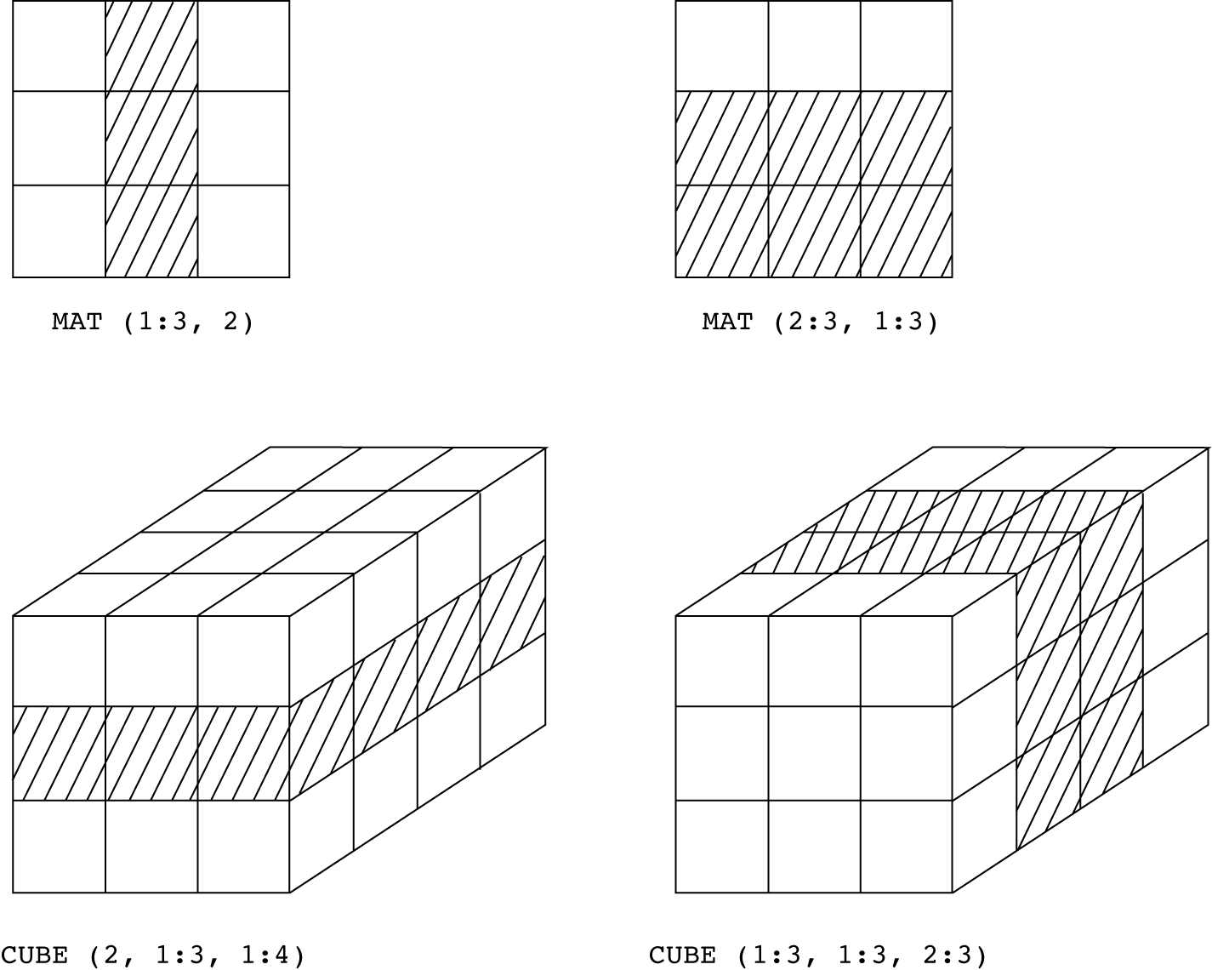
Slices Examples in Fortran 95

Slide 39
Implementation of Arrays
Access function maps subscript expressions to an address in the array
Access function for single-dimensioned arrays:
address(list[k]) = address (list[lower_bound]) + ((k-lower_bound) * element_size)

Slide 40
Accessing Multi-dimensioned Arrays
Two common ways:
  Row major order (by rows) – used in most languages
  column major order (by columns) – used in Fortran

Slide 41
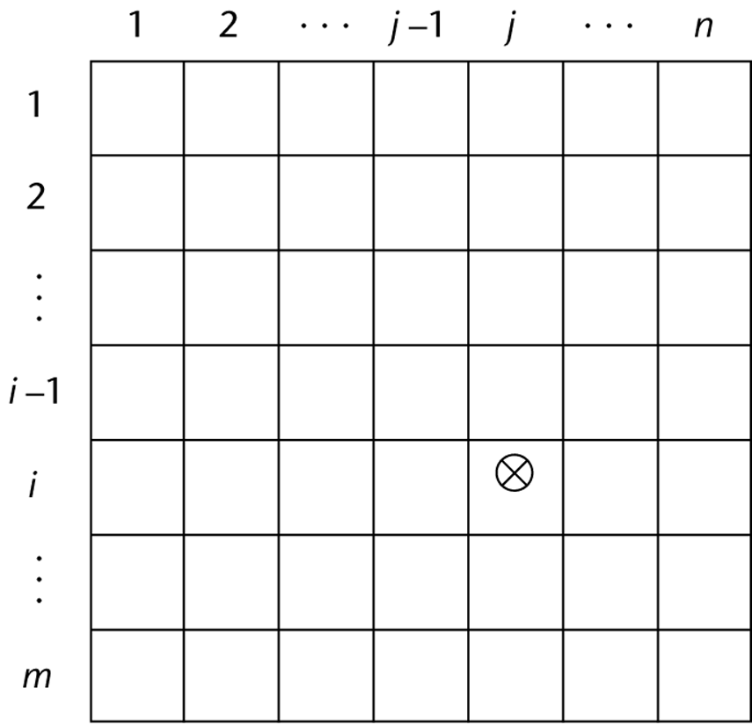
Locating an Element in a Multi-dimensioned Array
General format
Location (a[i,j]) = address of a [row_lb,col_lb] + (((i - row_lb) * n) + (j - col_lb)) * element_size

Slide 42
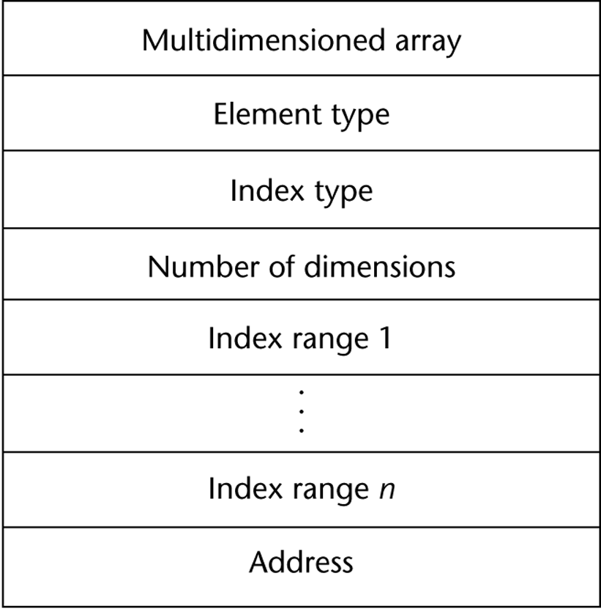
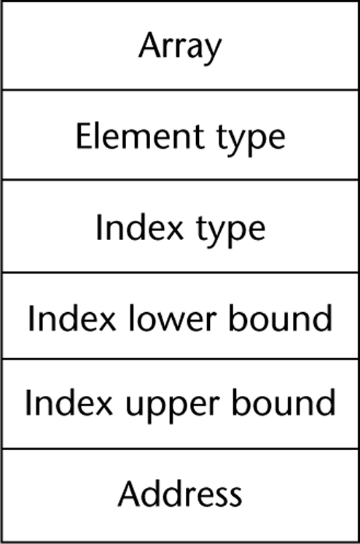
Compile-Time Descriptors
Single-dimensioned array
Multi-dimensional array

Slide 43
Associative Arrays
An associative array is an unordered collection of data elements that are indexed by an equal number of values called keys
  User-defined keys must be stored
Design issues:
  What is the form of references to elements?
  Is the size static or dynamic?

Slide 44
Associative Arrays in Perl
Names begin with %; literals are delimited by parentheses
  %hi_temps = ("Mon" => 77, "Tue" => 79, “Wed” => 65, …);
Subscripting is done using braces and keys
  $hi_temps{"Wed"} = 83;
  Elements can be removed with delete
  delete $hi_temps{"Tue"};

Slide 45
Record Types
A record is a possibly heterogeneous aggregate of data elements in which the individual elements are identified by names
Design issues:
  What is the syntactic form of references to the field?
  Are elliptical references allowed

Slide 46
Definition of Records in COBOL
COBOL uses level numbers to show nested records; others use recursive definition
  01 EMP-REC.
  02 EMP-NAME.
  05 FIRST PIC X(20).
  05 MID PIC X(10).
  05 LAST PIC X(20).
  02 HOURLY-RATE PIC 99V99.

Slide 47
Definition of Records in Ada
Record structures are indicated in an orthogonal way
type Emp_Rec_Type is record
First: String (1..20);
Mid: String (1..10);
Last: String (1..20);
Hourly_Rate: Float;
end record;
Emp_Rec: Emp_Rec_Type;

Slide 48
References to Records
Record field references
  1. COBOL
  field_name OF record_name_1 OF ... OF record_name_n
  2. Others (dot notation)
  record_name_1.record_name_2. ... record_name_n.field_name
Fully qualified references must include all record names
Elliptical references allow leaving out record names as long as the reference is unambiguous, for example in COBOL FIRST, FIRST OF EMP-NAME, and FIRST of EMP-REC are elliptical references to the employee’s first name

Slide 49
Operations on Records
Assignment is very common if the types are identical
Ada allows record comparison
Ada records can be initialized with aggregate literals
COBOL provides MOVE CORRESPONDING
  Copies a field of the source record to the corresponding field in the target record

Slide 50
Evaluation and Comparison to Arrays
Records are used when collection of data values is heterogeneous
Access to array elements is much slower than access to record fields, because subscripts are dynamic (field names are static)
Dynamic subscripts could be used with record field access, but it would disallow type checking and it would be much slower

Slide 51
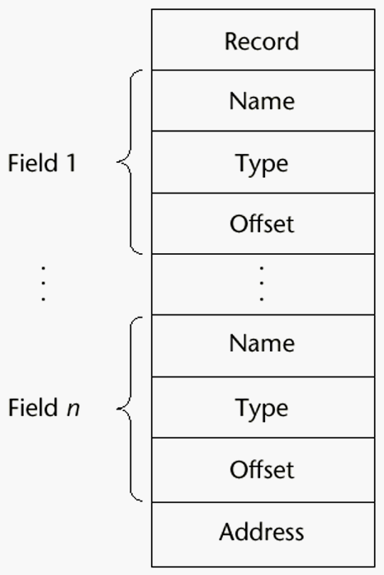
Implementation of Record Type
Offset address relative to the beginning of the records is associated with each field

Slide 52
Unions Types
A union is a type whose variables are allowed to store different type values at different times during execution
Design issues
  Should type checking be required?
  Should unions be embedded in records?

Slide 53
Discriminated vs. Free Unions
Fortran, C, and C++ provide union constructs in which there is no language support for type checking; the union in these languages is called free union
Type checking of unions require that each union include a type indicator called a discriminant
  Supported by Ada

Slide 54
Ada Union Types
type Shape is (Circle, Triangle, Rectangle);
type Colors is (Red, Green, Blue);
type Figure (Form: Shape) is record
Filled: Boolean;
Color: Colors;
case Form is
when Circle => Diameter: Float;
when Triangle =>
Leftside, Rightside: Integer;
Angle: Float;
when Rectangle => Side1, Side2: Integer;
end case;
end record;

Slide 55
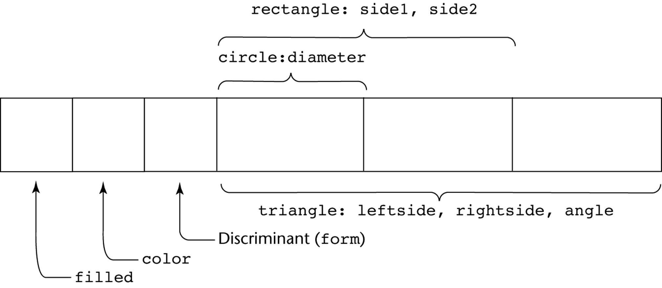
Ada Union Type Illustrated
A discriminated union of three shape variables

Slide 56
Evaluation of Unions
Free unions are unsafe
  Do not allow type checking
Java and C# do not support unions
  Reflective of growing concerns for safety in programming language
Ada’s descriminated unions are safe

Slide 57
Pointer and Reference Types
A pointer type variable has a range of values that consists of memory addresses and a special value, nil
Provide the power of indirect addressing
Provide a way to manage dynamic memory
A pointer can be used to access a location in the area where storage is dynamically created (usually called a heap)

Slide 58
Design Issues of Pointers
What are the scope of and lifetime of a pointer variable?
What is the lifetime of a heap-dynamic variable?
Are pointers restricted as to the type of value to which they can point?
Are pointers used for dynamic storage management, indirect addressing, or both?
Should the language support pointer types, reference types, or both?

Slide 59
Pointer Operations
Two fundamental operations: assignment and dereferencing
Assignment is used to set a pointer variable’s value to some useful address
Dereferencing yields the value stored at the location represented by the pointer’s value
  Dereferencing can be explicit or implicit
  C++ uses an explicit operation via *
  j = *ptr
  sets j to the value located at ptr

Slide 60
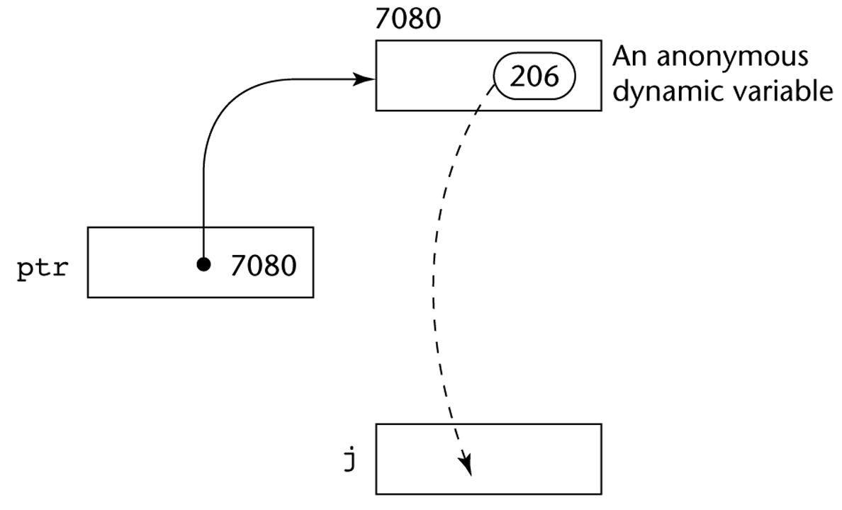
Pointer Assignment Illustrated
The assignment operation j = *ptr

Slide 61
Problems with Pointers
Dangling pointers (dangerous)
  A pointer points to a heap-dynamic variable that has been deallocated
Lost heap-dynamic variable
  An allocated heap-dynamic variable that is no longer accessible to the user program (often called garbage)
    Pointer p1 is set to point to a newly created heap-dynamic variable
    Pointer p1 is later set to point to another newly created heap-dynamic variable
    The process of losing heap-dynamic variables is called memory leakage

Slide 62
Pointers in C and C++
Extremely flexible but must be used with care
Pointers can point at any variable regardless of when or where it was allocated
Used for dynamic storage management and addressing
Pointer arithmetic is possible
Explicit dereferencing and address-of operators
Domain type need not be fixed (void *)
void * can point to any type and can be type
checked (cannot be de-referenced)

Slide 63
Pointer Arithmetic in C and C++
float stuff[100];
float *p;
p = stuff;
*(p+5) is equivalent to stuff[5] and p[5]
*(p+i) is equivalent to stuff[i] and p[i]

Slide 64
Reference Types
C++ includes a special kind of pointer type called a reference type that is used primarily for formal parameters
  Advantages of both pass-by-reference and pass-by-value
Java extends C++’s reference variables and allows them to replace pointers entirely
  References are references to objects, rather than being addresses
C# includes both the references of Java and the pointers of C++

Slide 65
Evaluation of Pointers
Dangling pointers and dangling objects are problems as is heap management
Pointers are like goto's--they widen the range of cells that can be accessed by a variable
Pointers or references are necessary for dynamic data structures--so we can't design a language without them

Slide 66
Representations of Pointers
Large computers use single values
Intel microprocessors use segment and offset

Slide 67
Dangling Pointer Problem
Tombstone: extra heap cell that is a pointer to the heap-dynamic variable
  The actual pointer variable points only at tombstones
  When heap-dynamic variable de-allocated, tombstone remains but set to nil
  Costly in time and space
Locks-and-keys: Pointer values are represented as (key, address) pairs
  Heap-dynamic variables are represented as variable plus cell for integer lock value
  When heap-dynamic variable allocated, lock value is created and placed in lock cell and key cell of pointer

Slide 68
Heap Management
A very complex run-time process
Single-size cells vs. variable-size cells
Two approaches to reclaim garbage
  Reference counters (eager approach): reclamation is gradual
  Mark-sweep (lazy approach): reclamation occurs when the list of variable space becomes empty

Slide 69
Reference Counter
Reference counters: maintain a counter in every cell that store the number of pointers currently pointing at the cell
  Disadvantages: space required, execution time required, complications for cells connected circularly
  Advantage: it is intrinsically incremental, so significant delays in the application execution are avoided

Slide 70
Mark-Sweep
The run-time system allocates storage cells as requested and disconnects pointers from cells as necessary; mark-sweep then begins
  Every heap cell has an extra bit used by collection algorithm
  All cells initially set to garbage
  All pointers traced into heap, and reachable cells marked as not garbage
  All garbage cells returned to list of available cells
  Disadvantages: in its original form, it was done too infrequently. When done, it caused significant delays in application execution. Contemporary mark-sweep algorithms avoid this by doing it more often—called incremental mark-sweep

Slide 71
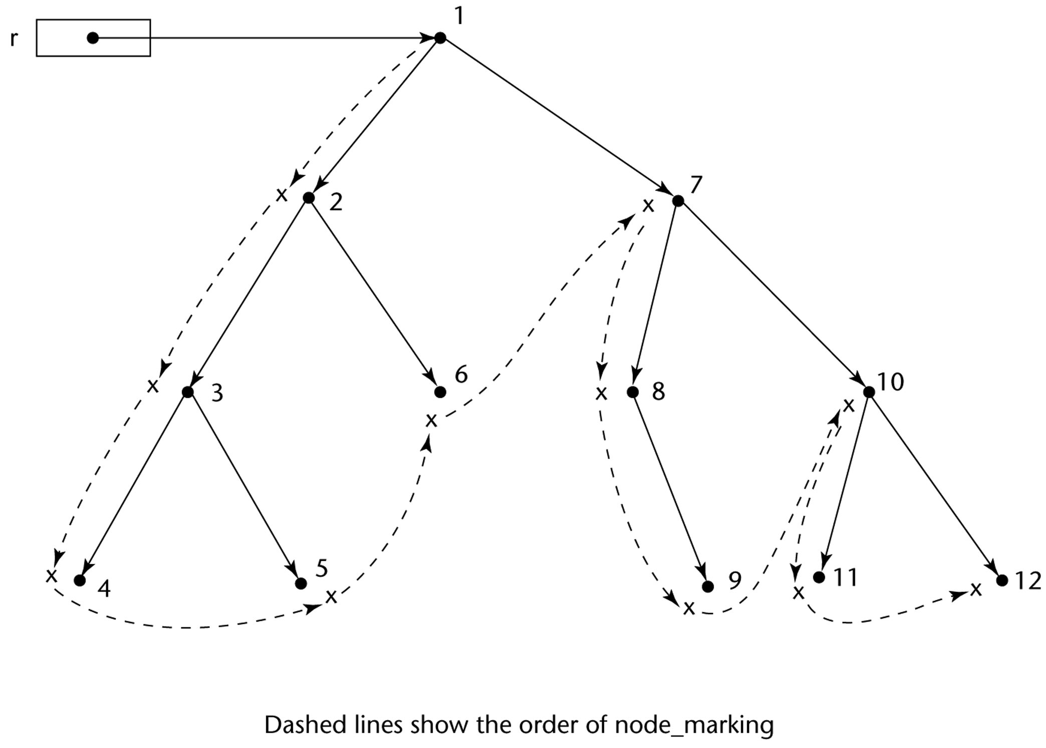
Marking Algorithm

Slide 72
Variable-Size Cells
All the difficulties of single-size cells plus more
Required by most programming languages
If mark-sweep is used, additional problems occur
  The initial setting of the indicators of all cells in the heap is difficult
  The marking process in nontrivial
  Maintaining the list of available space is another source of overhead

Slide 73
Summary
The data types of a language are a large part of what determines that language’s style and usefulness
The primitive data types of most imperative languages include numeric, character, and Boolean types
The user-defined enumeration and subrange types are convenient and add to the readability and reliability of programs
Arrays and records are included in most languages
Pointers are used for addressing flexibility and to control dynamic storage management

